Slide 1
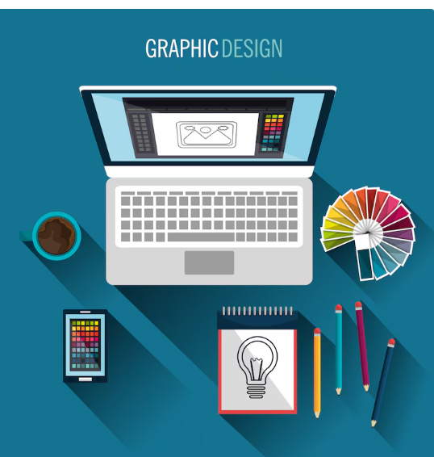
Internship Report Presentation On Graphics Design And Branding
Prepared by :Sirish Bhandari
Roll NO :12279/20

Slide 2
Introduction
Overview of Internship
As Partial fufilment of requirement for degree in bachelor in information management I had completed 3 months internship at Print Patra (a graphics design company located at Nayabajar Pokhara) in Graphics Design and Branding. Beginning from Poush 3 – Chaitra 5 on supervision of Respected sir Mr. Arjan Dhungel. I was excited to learn a lot of new concept during my tenure .
My main objective of internship are as below:
1.To Perfect designing tools such as Canva Adobe Photoshop etc.
2.To Improve communication among team members and clients.
3.To be familiar with office working environment.

Slide 3
Introduction
I chose the role as graphics designer because it involves creativity and I like creativity rather than just knowledge and the company became my choice because its sole purpose is to design visually appealing graphics for printing, branding promotion etc.
Organization Profile
Name: Print Patra
Nature of Business : Printing, Advertising, Designing
Services Offered: Customized stickers, Brand Promotion, Digital Graphics, Banners Posters, Hoarding Boards etc.

Slide 4
Roles And Responsiblities
My Position: Graphics design and Branding Intern
Schedule:11 - 4
Tools /software used : Canva, Adobe Photoshop, Adobe illustrator.
Tasks Performed:
-Designing visually appealing social media posts
-Branding and print material
-client revisions and feedback

Slide 5
Introduction To Design Industry
The world today almost computerized form agriculture to high tech IT Industry. Everything works with representation on an screen. There comes the role of graphics.
Graphic design is the art of using visual elements to communicate messages.
Grphics Design follows certain principles such as contrast, repetition,balance, hierarchy, space, alignment, typography etc

Slide 6
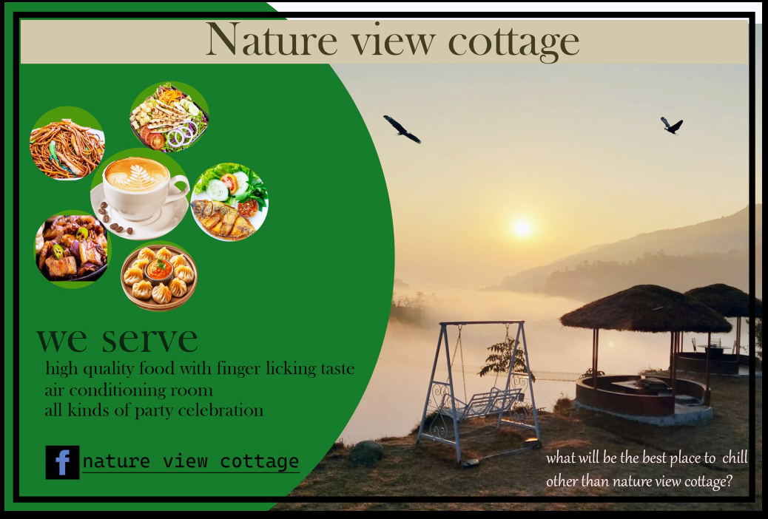
Projects Undertaken
1 Banner For Nature View Cottage Resturant.
This was one of the design I created for branding of restaurant named nature view cottage

Slide 7
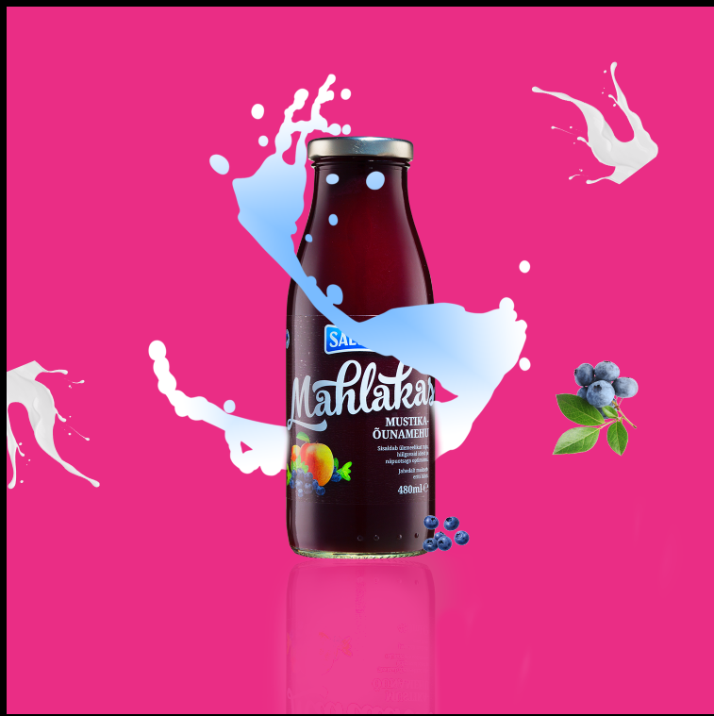
Project Undertaken
This was another project I practiced on. This is product manipulation project where I am creating a visually appealing design for berry juice with the help of adobe photoshop.

Slide 8
Learning Outcome
Technica skills along with understanding of design theory
Soft skill was improved which include good communication habit confidence to talk with new people etc.
Understanding of designing industry so to become able to d o work or open designing business for self.

Slide 9
Challenges and Solutions
Challenges
Busy schedule and heavy workload on occasions.
Mastering pen tool was a bit more tough for me.
Conflicting situation between client need and design theory.
Solutions
During Busy time I would handover project to supervisor or ask for extra time .
I would tell client about what a better design actually is.
Pen tool was too difficult but I gave more of my time to learn it.

Slide 10
Critical Analysis
The internship went well overall. Supervisor Mr. Arjan Dhungel sir was collaborative and supportive. I Also got chance to work from home on occasions.
Overall experience was well but it could be better if I had more chances to meet with client than I was given.
During my tenure I learned how designing works how to foster my creativity and if I needed to search for new job I can surely secure it.

Slide 11
Conclusion
Final Thoughts
This internship really help upskill my creativity and design skills.
This internship helped a lot on my personal growth and
recognization of a huge network of people in designing industry.
I absolutely do recommend others engage in internship opportunity in this company if possible.

